Slide 1
Hate-speech detection
By:
SHIRISHA.YR
RAHUL NADIG
ANANYA.D
KEERTHANA.S

Slide 2





CONTENTS:
AIM AND ALGORITHMS USED
WORKING
PYTHON LIBRARIES USED
CODE SNIPPETS
RESULT

Slide 3
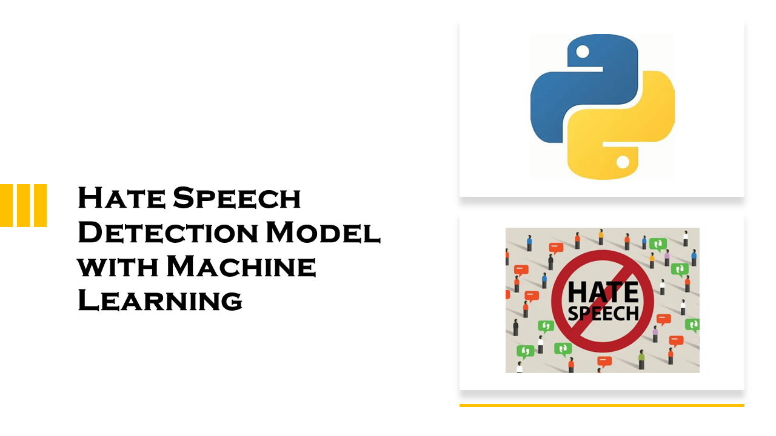
AIM OF THIS PROJECT:
Hate speech can be defined as any speech that targets a group of people based on their race, religion, ethnicity, national origin, sexual orientation, or gender identity. Hate speech is often used to spread hate and bigotry. It can also be used to intimidate and threaten people. It can make people feel isolated, anxious, and scared. It can also lead to hate crimes.
Machine learning is a type of artificial intelligence that can be used to learn from data. It can be used to find patterns in data
These algorithms can analyze text and identify hate speech. They can also be used to determine the tone of a text. This can be used to identify hate speech that is disguised as jokes or sarcasm. Automated hate speech detection is an important tool in combating the spread of hate speech, particularly in social media.

Slide 4
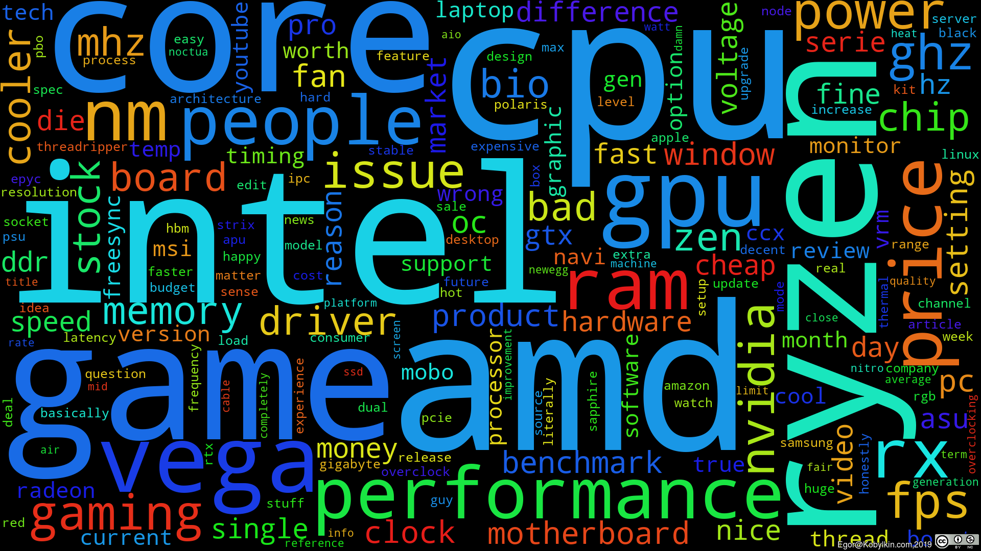
ALGORITHMS USED:
Logistic regression is a type of supervised machine learning algorithm that can be used for classification tasks, such as sentiment analysis, spam detection, or text categorization. Logistic regression works by learning a function that maps input features (such as words or n-grams) to output labels (such as positive or negative) using a set of parameters that are optimized by minimizing a cost function. Logistic regression can handle both binary and multi-class classification problems by using different variants of the function, such as sigmoid or softmax.
In natural language processing, logistic regression is often used as a baseline algorithm for classification, because it is simple, fast, and effective. Logistic regression can also be seen as a building block for more complex models, such as neural networks, which can be viewed as a series of logistic regression classifiers stacked on top of each other. Logistic regression can also be combined with other techniques, such as feature extraction, preprocessing, or regularization, to improve its performance and generalization.

Slide 5
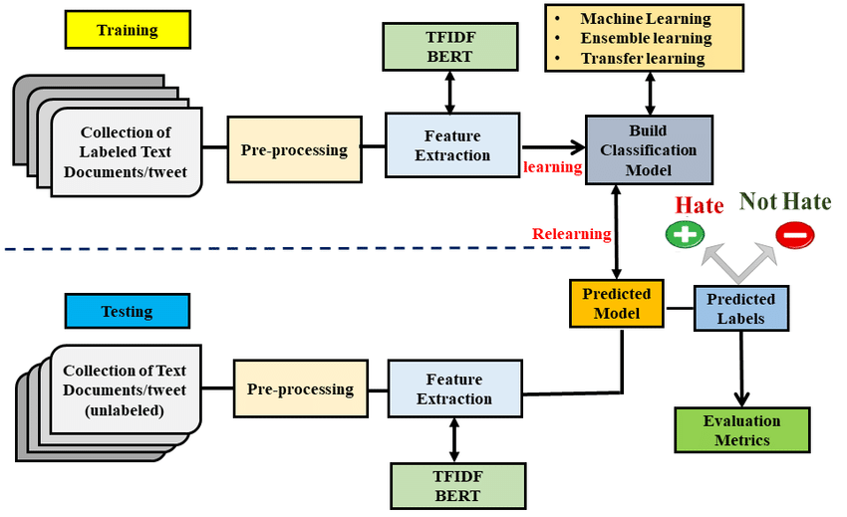
WORKING
Collected a hate speech dataset: We used a dataset of labelled examples of hate speech and non-hate speech.
Pre-processing the data: Pre-processing involves cleaning and transforming the raw text data into a format that the machine learning algorithm can use. Some common pre-processing steps include tokenization, stop word removal, and stemming.
Feature extraction: This step involved extracting relevant features from the pre-processed text..
Train the model: We divided our dataset into training and validation sets. Use the training set to train your machine learning model.
Evaluate the model: Use the validation set to evaluate the performance of your model. Common evaluation metrics include precision, recall, F1 score, and accuracy.

Slide 6
LITERATURE REVIEW:
"Automated Hate Speech Detection and the Problem of Offensive Language" by Davidson, T., et al. (2017). This paper presents a study on the problem of automated hate speech detection. The authors create a dataset of Twitter posts labelled as hate speech or not, and experiment with various machine learning techniques for
classification.
"Hate Speech Detection with Comment Embeddings and LSTM Networks" by Wulczyn, E., et al. (2017). This paper proposes a hate speech detection model that uses LSTM networks and comment embeddings. The authors use a large dataset of comments from online forums and social media platforms to train the model.
"Deep Learning for Hate Speech Detection in Tweets" by Badjatiya, P., et al. (2017). This paper presents a deep learning approach for hate speech detection on Twitter. The model uses a combination of convolutional and LSTM layers for feature extraction and classification.

Slide 7
PYTHON LIBRARIES USED:
Pandas: Pandas is a powerful data manipulation library for Python. It provides data structures like DataFrame and Series, which are designed for efficiently manipulating large datasets.
NumPy :NumPy is a library for numerical computations in Python. It provides support for large, multi-dimensional arrays and matrices, along with mathematical functions to operate on these arrays.
Matplotlib:
Matplotlib is a 2D plotting library for Python. It enables you to create a wide variety of static, animated, and interactive visualizations in Python.
Seaborn :
Seaborn is a statistical data visualization library based on Matplotlib. It provides a high-level interface for drawing attractive and informative statistical graphics.
NLTK :
NLTK, or the Natural Language Toolkit, is a library for working with human language data. It provides easy-to-use interfaces to lexical resources, such as WordNet, and processing text, including tokenization, stemming, and part-of-speech tagging.
.

Slide 8
WordCloud:
WordCloud is a library for creating word clouds, which are visual representations of text data. It is often used to show the most frequently occurring words in a body of text.
Scikit-learn:
Scikit-learn is a machine learning library for Python. TfidfVectorizer is a feature extraction method that converts a collection of raw documents to a matrix of TF-IDF features.
Scikit-learn provides tools for machine learning, including data splitting. train_test_split is used to split datasets into training and testing sets for model evaluation.
Scikit-learn's LogisticRegression is a linear model for binary classification. It's commonly used for tasks where the dependent variable is binary (two classes).
Scikit-learn provides various metrics for evaluating the performance of machine learning models. accuracy_score, classification_report, confusion_matrix, and ConfusionMatrixDisplay are tools for assessing classification model performance.

Slide 9
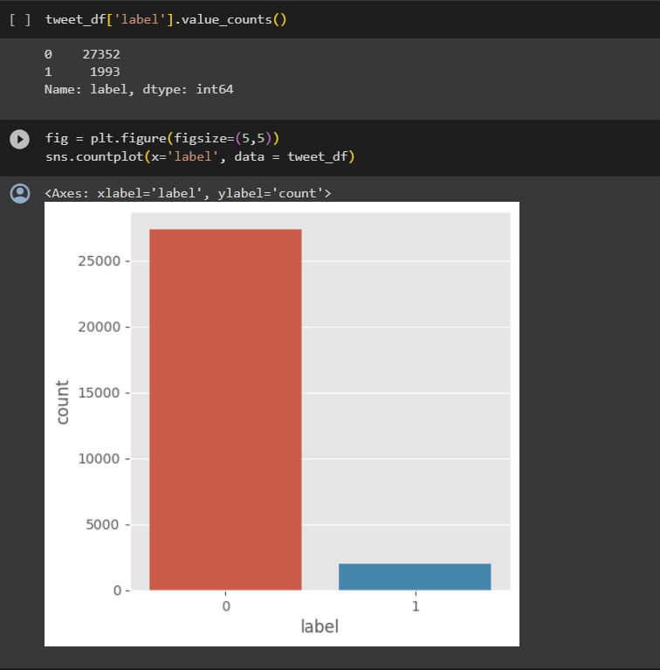
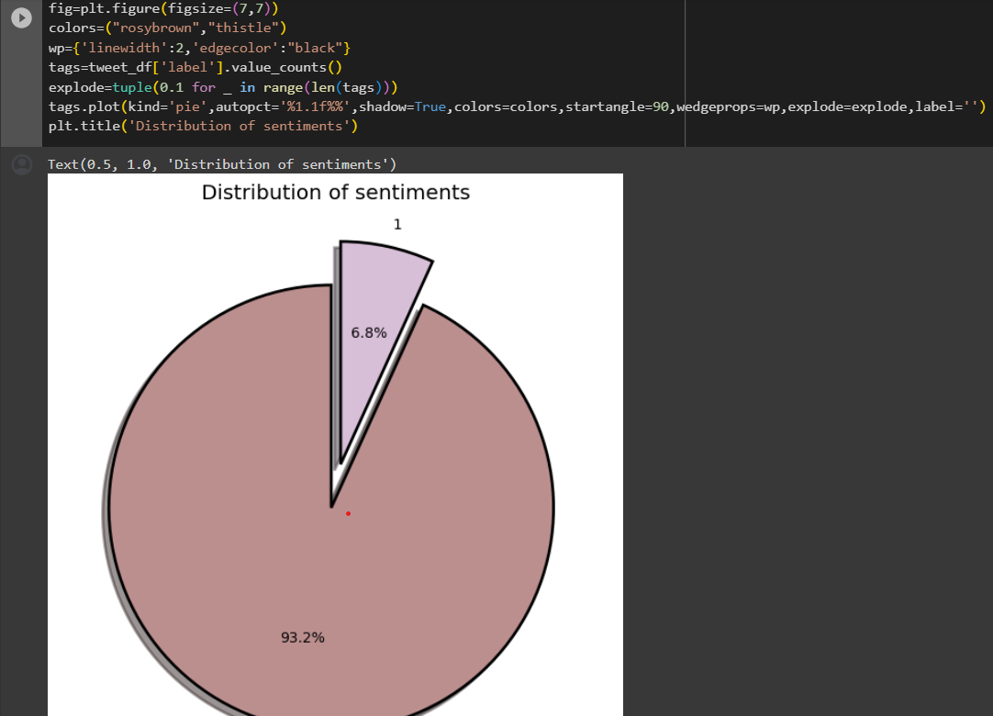

Slide 10
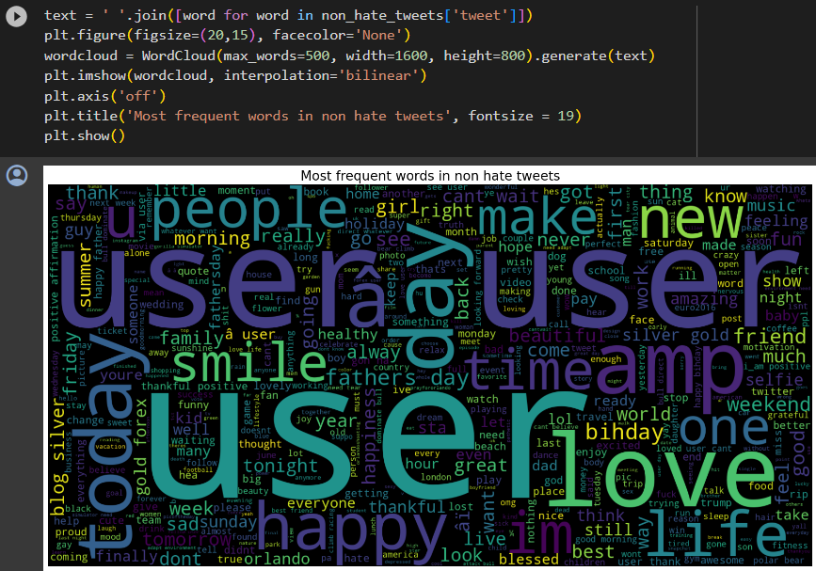
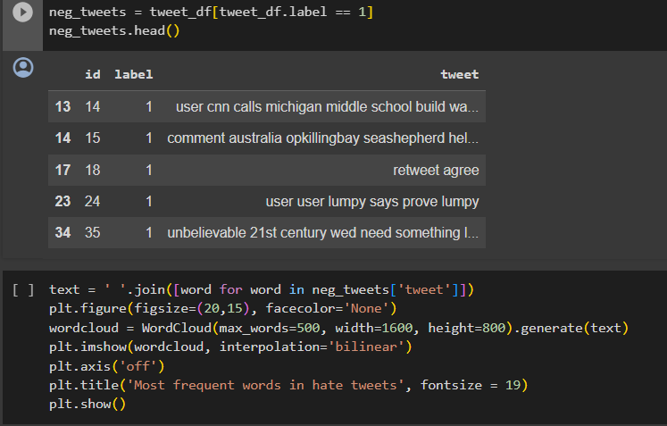

Slide 11
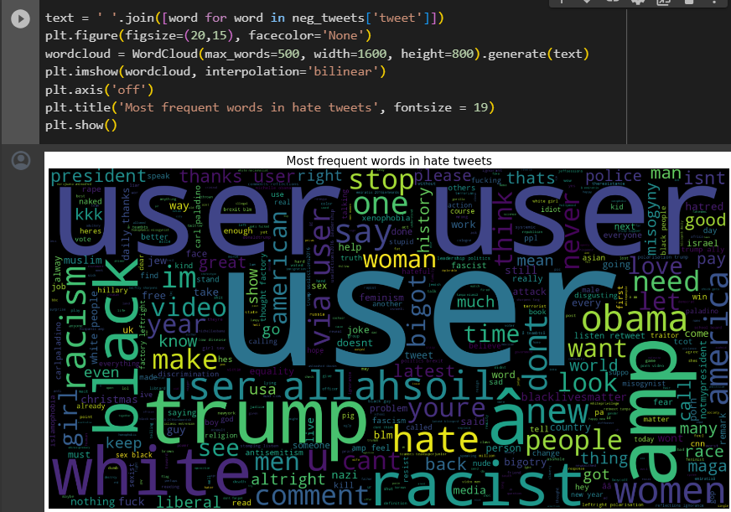
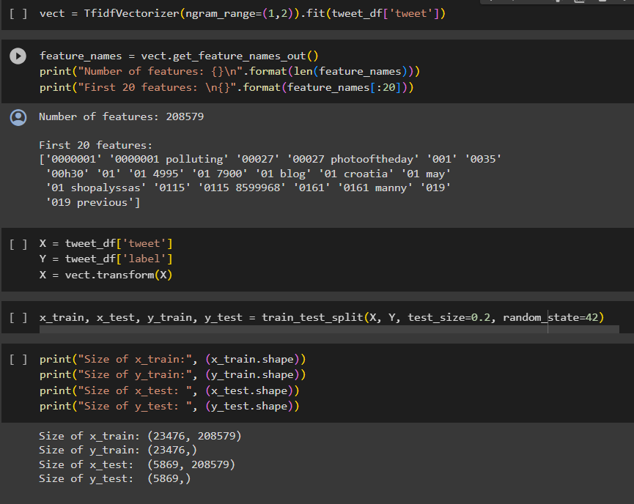

Slide 12
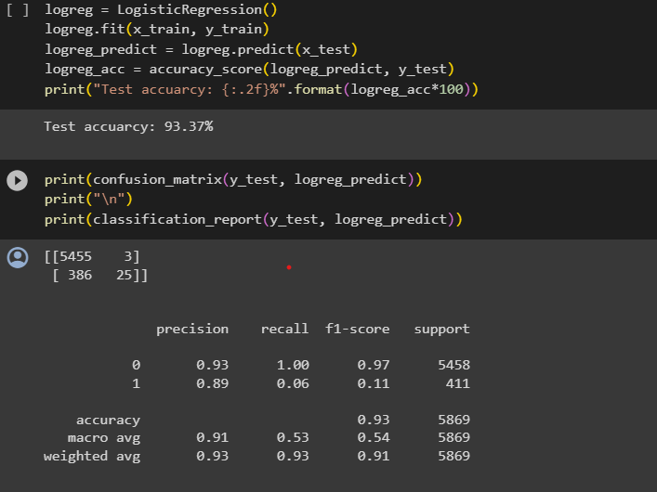
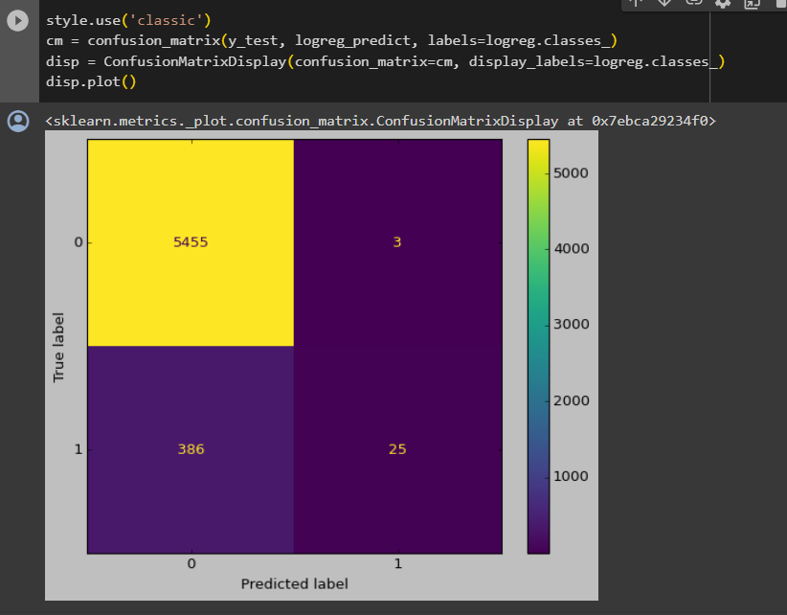

Slide 13
ACCURACY:

Slide 14
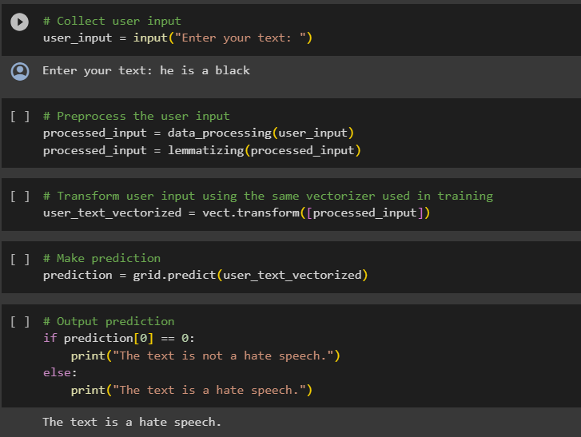
RESULT:

Slide 15
Thank You

